Slide 1
Three schema Architecture
The Three schema architecture is also called ANSI/SPARC architecture or three-level architecture.
This schema is used to describe the structure of a specific database system.
The three-schema architecture is also used to separate the user applications from physical database.
The three-schema architecture contains three-levels. It breaks the database down into three different categories.

Slide 2
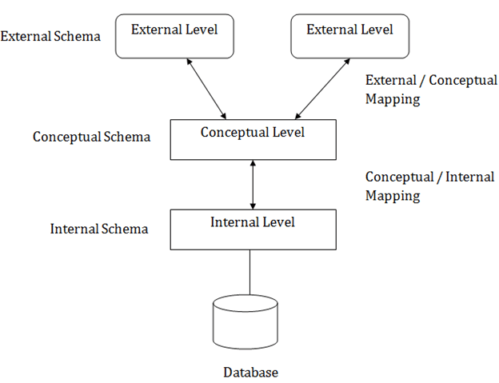

Slide 3
Physical Level: At the physical level, the information about the location of database objects store is kept. Various users of DBMS are unaware of the locations of these objects. In simple terms, physical level of a database describes how the data is being stored in secondary storage devices like disks and tapes and also gives insights on additional storage details.
Conceptual Level: At conceptual level, data is represented in the form of various database tables. For Example, STUDENT database may contain STUDENT and COURSE tables which will be visible to users, but users are unaware of their storage. Also referred as logical schema, it describes what kind of data is to be stored in the database.

Slide 4
External Level: An external level specifies a view of the data in terms of conceptual level tables. Each external level view is used to cater to the needs of a particular category of users.
For Example, FACULTY of a university is interested in looking course details of students, STUDENTS are interested in looking at all details related to academics, accounts, courses and hostel details as well. So, different views can be generated for different users.
The main focus of external level is data abstraction

Slide 5
Data Independence
Data independence means a change of data at one level should not affect another level. Two types of data independence are present in this architecture:
Physical Data Independence: Any change in the physical location of tables and indexes should not affect the conceptual level or external view of data. This data independence is easy to achieve and implemented by most of the DBMS.

Slide 6
Conceptual Data Independence: The data at conceptual level schema and external level schema must be independent. This means a change in conceptual schema should not affect external schema. e.g.; Adding or deleting attributes of a table should not affect the user’s view of the table. But this type of independence is difficult to achieve as compared to physical data independence because the changes in conceptual schema are reflected in the user’s view.

Slide 7
Advantages of DBMS
DBMS helps in efficient organization of data in database which has following advantages over typical file system:
Minimized redundancy and data inconsistency: Data is normalized in DBMS to minimize the redundancy which helps in keeping data consistent. For Example, student information can be kept at one place in DBMS and accessed by different users. This minimized redundancy is due to primary key and foreign keys
Simplified Data Access: A user need only name of the relation not exact location to access data, so the process is very simple.

Slide 8
Multiple data views: Different views of same data can be created to fulfill the needs of different users. For Example, faculty salary information can be hidden from student view of data but shown in admin view.
Data Security: Only authorized users are allowed to access the data in DBMS. Also, data can be encrypted by DBMS which makes it secure.
Concurrent access to data: Data can be accessed concurrently by different multiple users at same time in DBMS.
Backup and Recovery mechanism: DBMS backup and recovery mechanism helps to avoid data loss and data inconsistency in case of catastrophic failures.

Slide 9
Disadvantages of DBMS
Increased Cost:Cost of Hardware and Software: high-speed processor and also a large memory size.
Expensive and sophisticated hardware and software
Training (all levels including programming, application development, and database administration), licensing, and regulatory compliance costs very high.
Cost of Staff Training:Educated staff (database administrator, application programmers, data entry operations)

Slide 10
5.Cost of Data Conversion: convert our data into a database management system,hire database system designers,
6.Complexity: DBMS is very complex to operate and manage. It requires skilled personnel to maintain
7.Compatibility: DBMS software may not be compatible with other software systems or platforms, making it difficult to integrate with other applications
8.Security: A DBMS can be vulnerable to security breaches if not properly configured and managed. This can lead to data loss or theft.

Slide 11
Dependence on technology :
Not beneficial for small firms:
Frequent upgrade issue:
Scalability : The DBMS system may need help to handle increasing database size. Because of this increase in database size, complexity will increase, This can be a costly and time-consuming process.

